Slide 1
DRIVER ALERTNESS DETECTION (PSCS204)
PIP2001 Capstone Project
Review-Final Viva Voce
Batch Number: CDV-05
Under the Supervision of,
Mr. Rajan. T,
Assistant Professor,
School of Computer Science and Engineering,
Presidency University, Bengaluru.
Roll Number | Student Name
20211CDV0053 | HARISH BHASKARAN
20211CDV0068 | RUTHWICK S S
20211CDV0018 | RAGHAVENDRA RAKESH
20211CDV0065 | KAVANA S K

Slide 2

Contents
Introduction
Literature Review
Existing method drawbacks
Proposed Method
Objectives
Methodolgy / Modules
Architecture
Hardware &Software components
Timeline of Project
Expected Outcomes
Conclusion
References

Slide 3
Introduction
Driver alertness is a vital factor in ensuring road safety. Drowsy and impaired driving accounts for a significant percentage of traffic accidents.
The integration of these components aims to provide real-time feedback to drivers, thereby enhancing their safety and reducing the likelihood of accidents.

Slide 4
Literature Review
Sl. No. | Paper Title | Paper Author | Techniques Used | Merits | Demerits
1 | Driver fatigue detection technology in active safety systems | Qiong Wang; Huan Wang and team Published - 2011 | Eye Tracking, Behavioral Analysis, Facial Recognition, Vehicle Performance Metrics. | High accuracy, Utilizes existing vehicle data, Assesses signs of fatigue, Real-time data for feedback. | Requires specific hardware & lighting, May not distinguish fatigue from other issues, requires good imaging, may not detect fatigue until severe
2 | Drivers’Drowsiness Detection and Warning Systems for Critical Infrastructures | Ioana-Raluca Adochiei and team Published - 2020 | Video based monitoring, Wearable sensors, Machine learning algorithms, Steering pattern analysis. | High accuracy, Continuous monitoring, Can analyze complex patterns, Leverages existing vehicle data for easy integration. | Requires good lighting and camera quality, May cause discomfort, Requires large datasets for training, May not always indicate fatigue reliably

Slide 5
Literature Review
3 | Smart Vehicle Safety System with Alcohol and Drowsiness Detection, Eye Tracking, and SMS Alert System | Earl Levi P. Parel; Gerzon Jil Y, Miranda, Ernesto Vergara Published - 2023 | Alcohol detection sensors, Eye tracking, Drowsiness Detection Algorithms | Accurate detection, High precision, Utilizes machine learning | False positives possible, requires good lighting & camera quality
4 | An Integrated Framework for Driver Drowsiness Detection and Alcohol Intoxication using Machine Learning | Renju Rachel Varghese and team Published - 2021 | Sensor fusion, Behavioral analysis, Real Time Alerts | Combines data from multiple sensors, real time assessment of driving patterns, Immediate notifications | Increased complexity in data processing, may not detect all types of fatigue, May cause alarm fatigue

Slide 6
Literature Review
5 | Drowsiness Alert, Alcohol Detect and Collision Control for Vehicle Acceleration | Ranjit Patnaik and team Published - 2020 | Alcohol Detection systems, Camera based monitoring, Drowsiness detection sensors | Accurately measures blood alcohol content, High precision, Provides real-time monitoring of driver alertness | Limited to specific substances, Sensitive to environment-al conditions, May have false negatives or positives.
6 | Driver Drowsiness Detection and Alerting Model for Minimizing Road Accidents | R. Sathya; D. Sai Surya Harsha and team Published – 2023 | Eye Tracking, Physicologi-cal Monitoring, Alert System | High accuracy, Continuous assessme--nt, Immediat-e notification | Requires good lighting & camera quality, May be invasive, Potential for alarm fatigue

Slide 7
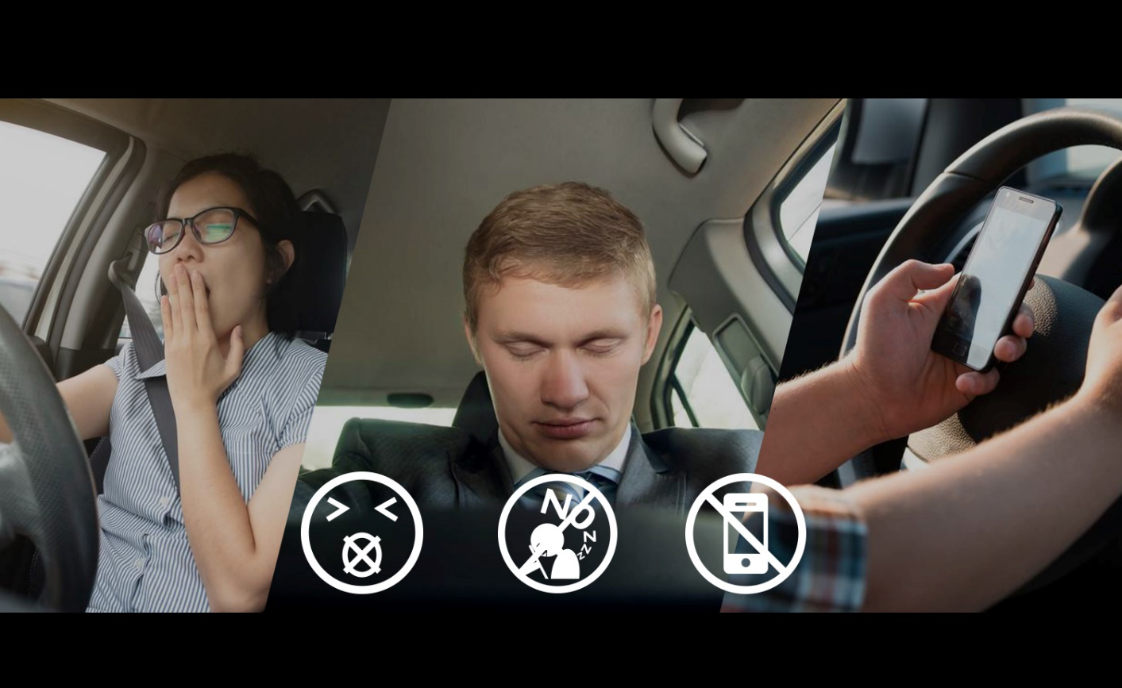
Existing method Drawback
Driver alert systems aim to enhance safety by monitoring driver behavior and alerting them to potential drowsiness or distraction. However, they have several drawbacks:
False Positives
Over-Reliance
Limited Context
Adaptation Issues
Cost and Maintenance

Slide 8
Proposed Method
To enhance driver alert systems, consider the following proposed methods:
Adaptive Algorithms
Contextual Awareness
User Customization
Feedback Loop
Education and Awareness

Slide 9

Objectives
Increase Driver Safety
Improve Alert Accuracy
Enhance User Experience
Foster Driver Awareness
Utilize Advanced Technologies

Slide 10
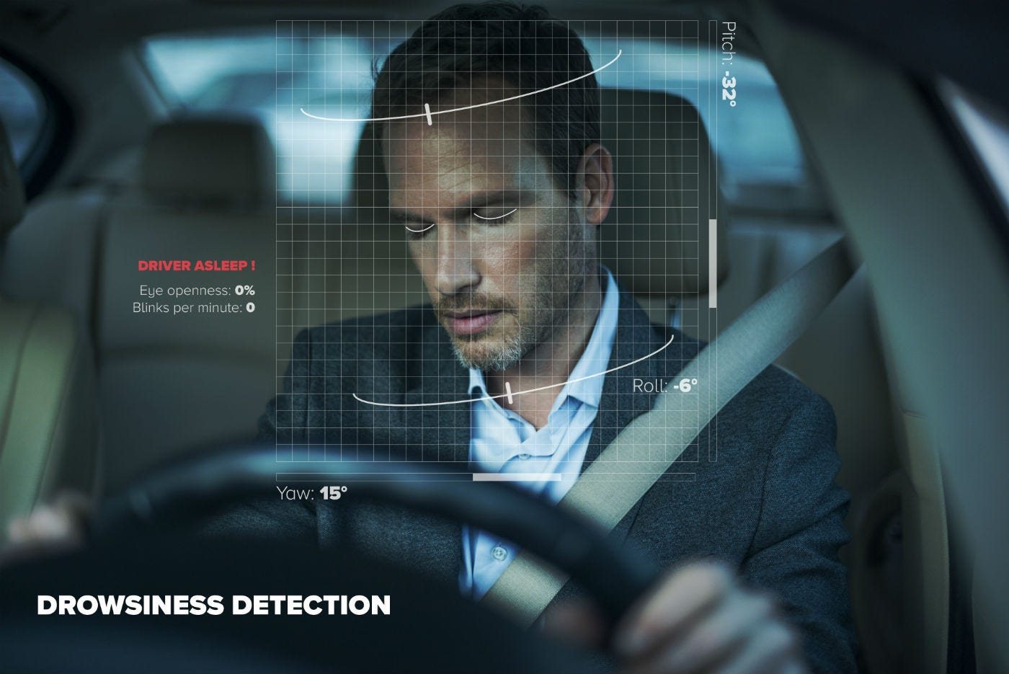
Methodology/Modules
Here’s a proposed methodology for enhancing driver alert systems:
Requirements Analysis
System Design
Development and Integration
Testing and Validation
User Training and Feedback
Deployment and Monitoring
Continuous Improvement

Slide 11
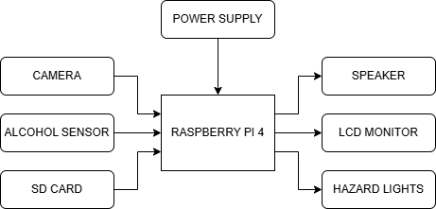
Architecture

Slide 12
Hardware & Software components
Hardware components
Raspberry Pi Model 4
Alcohol Sensor
Camera
Speaker
Cables & Connectors
LCD Monitor
Software components
Visual Studio Code
VNC viewer
Open CV
Imutils
Scipy
Dlib

Slide 13
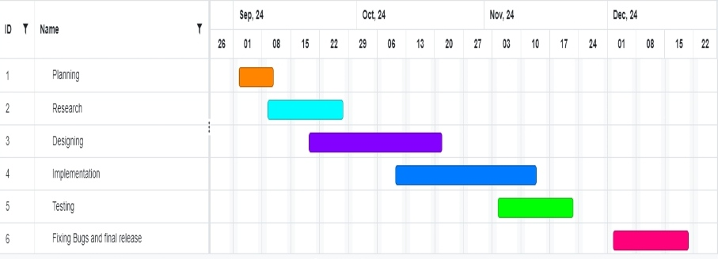
Timeline of Project

Slide 14
Expected Outcomes
A fully functional prototype capable of detecting driver drowsiness and alcohol impairment.
Real-time feedback mechanisms that alert the driver visually and audibly when alertness is low or when alcohol is detected.
A comprehensive understanding of the effectiveness of integrating multiple technologies to enhance driver safety.

Slide 15
Conclusion
Driver alertness detection is an essential aspect of enhancing road safety in the face of increasing traffic accidents attributed to drowsiness and alcohol impairment.
This review has highlighted the critical role of advanced technologies in monitoring driver conditions and providing timely interventions.
The integration of systems utilizing Raspberry Pi for real-time processing, alongside alcohol sensors for breath analysis, presents a comprehensive approach to mitigating these risks.

Slide 16

Github Link
Driver Alertness System

Slide 17
References
[1] Wang, N. Q., Wang, N. H., Zhao, N. C., & Yang, N. J. (2011). Driver fatigue detection technology in active safety systems. International Conference on Remote Sensing, Environment and Transportation Engineering. https://doi.org/10.1109/rsete.2011.5964969
[2] Adochiei, I., Stirbu, O., Adochiei, N.-. I., Pericle-Gabriel, M., Larco, C., Mustata, S., & Costin, D. (2020). Drivers’ drowsiness detection and warning systems for critical infrastructures. 2020 International Conference on e-Health and Bioengineering (EHB). https://doi.org/10.1109/ehb50910.2020.9280165
[3] Parel, E. L. P., Miranda, G. J. Y., & Vergara, E. (2023). Smart Vehicle Safety System with Alcohol and Drowsiness Detection, Eye Tracking, and SMS Alert System. IEEE, 254–258. https://doi.org/10.1109/ecice59523.2023.10383169
[4] Varghese, R. R., Jacob, P. M., Jacob, J., Babu, M. N., Ravikanth, R., & George, S. M. (2021). An Integrated Framework for Driver Drowsiness Detection and Alcohol Intoxication using Machine Learning. 2021 International Conference on Data Analytics for Business and Industry (ICDABI), 531–536. https://doi.org/10.1109/icdabi53623.2021.9655979
[5] Patnaik, R., Krishna, K. S., Patnaik, S., Singh, P., & Padhy, N. (2020). Drowsiness alert, alcohol detect and collision control for vehicle acceleration. 2020 International Conference on Computer Science, Engineering and Applications (ICCSEA). https://doi.org/10.1109/iccsea49143.2020.9132932
[6] Sathya, R., Harsha, D. S. S., Krishna, M. G., Reddy, G. P. S., & Arhith, P. (2023). Driver Drowsiness Detection and Alerting model for minimizing road accidents. 2020 IEEE International Students’ Conference on Electrical,Electronics and Computer Science (SCEECS), 118, 1–6. https://doi.org/10.1109/sceecs57921.2023.10063113
[7] Lin, L., Tsai, H., Li, Y., Chen, H., & Li, L. (2023). Driver Fatigue Detection Using TGAM EEG Signal Processing Module. IEEE, 984–986. https://doi.org/10.1109/ecice59523.2023.10383120

Slide 18
Publication Details

Slide 19

Project work mapping with SDG

Slide 20
Thank You

